Slide 1


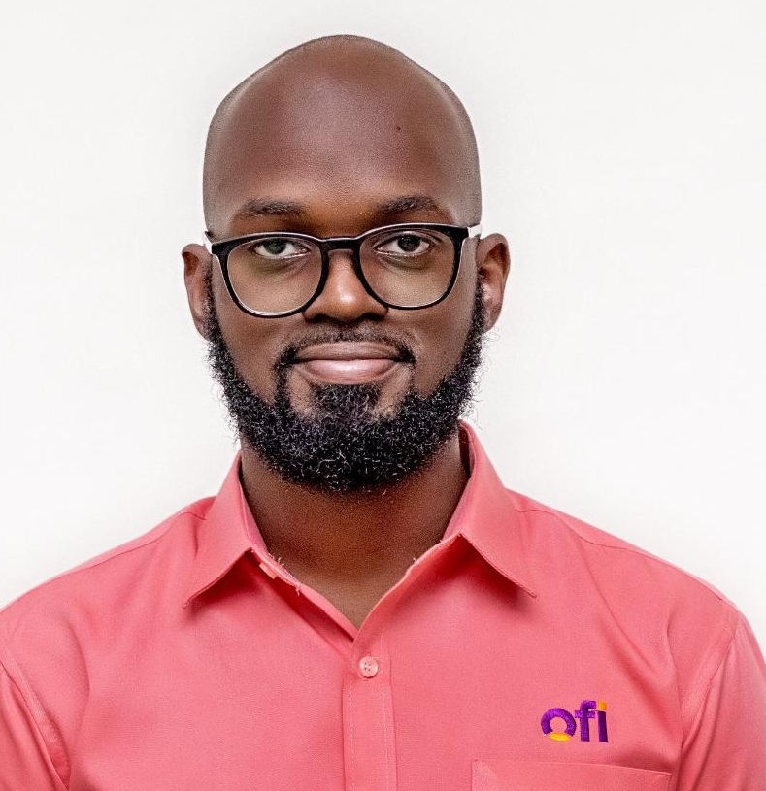
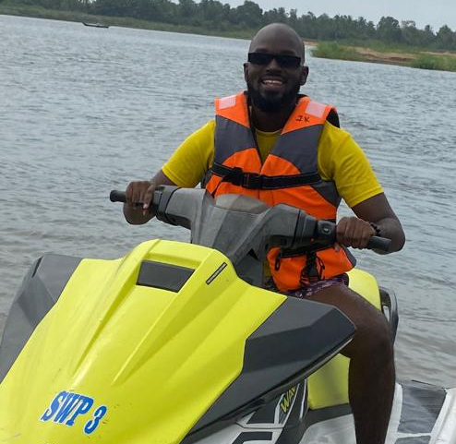
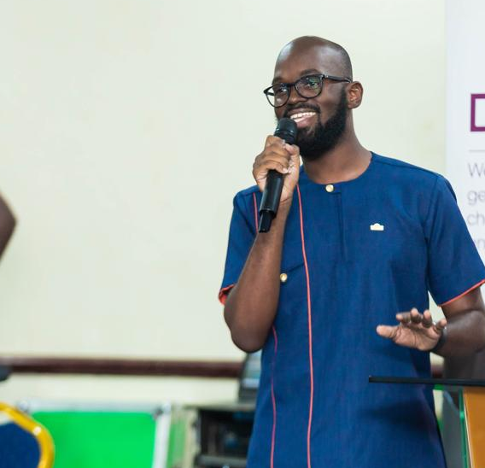
Getting to Know Me
Work
Personal
My role
Senior Communications Officer
Significant others / family members / furry friends in my life
My parents- Jospeh and Naa Andoh
Tenure in ofi/Olam
1 year
How I enjoy spending my free time
Reading
Previous companies I have worked at
Touchpoint Ghana
My favorite / comfort food
Kenkey
Why I joined ofi/Olam and what keeps me here?
I joined ofi for the Opportunity to grow and learn more and so far I have learnt a lot!
My favorite song
Jireh- Maverick City
Papa Nyan Andoh
Papa Nyan
A few fun facts about me
I enjoy baking, and I am very competitive when it comes to board games!
This is me outside work, doing stuff I enjoy in my life …

